Slide 1
2023 Internship Group Presentations
Berlin, 31.08.2023

Slide 2
Topic Overview / Agenda
BeIntelli
TP2: AI Middleware - Edge Cloud
TP3: Extrinsic Camera and Lidar Calibration
TP3: Localization by Visual Place Recognition
TP3: Free Parking Space Detection
TP4: Smart Parking Recommendation
TP4: AI Platform and Tools
COBRA-5G
Pod/Container-Monitoring in K8s Clusters
Go-KI
Smart Fridge - Object Detection
Ground Assistance System - Voice Interaction

Slide 3
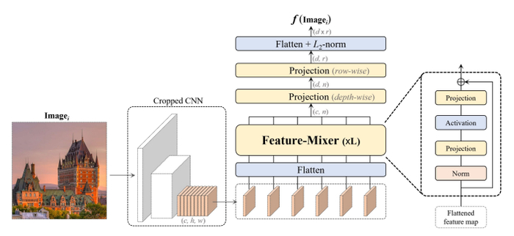
Localization by Visual Place Recognition
Topic 3
BeIntelli TP3
Group member:
Ahmet Alperen Güngör
Supervisor:
Ketan Motlag / Srinivas Ravuri
To improve the initialization of the localization algorithm^{[1]}
Recognize environment by camera data using a NN-based regression model (MixVPR)^{[2]}
Locate where our vehicle is and output GNSS coordinates.

Slide 4
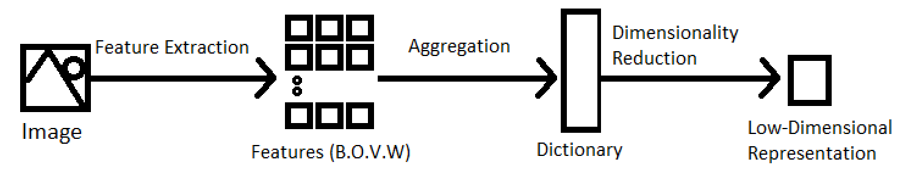
Literature Review - Manual Approaches:
BeIntelli TP3
Challenges:^{[3][4]}
1)Viewpoint Change 2)Perceptual Aliasing 3)Appearance Change
Process:
Local (SIFT^{[5]} /SURF^{[6]}) or Global (GIST^{[7]}) Feature Extraction
Aggregation (VLAD^{[8][9]})
Dimensionality Reduction (PCA)

Slide 5
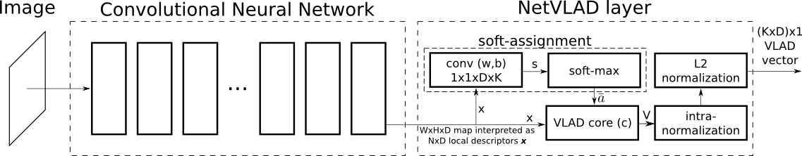
End-to-End Deep Learning Approaches:
BeIntelli TP3
NetVLAD^{[10][11][12]}:
MixVPR:

Slide 6
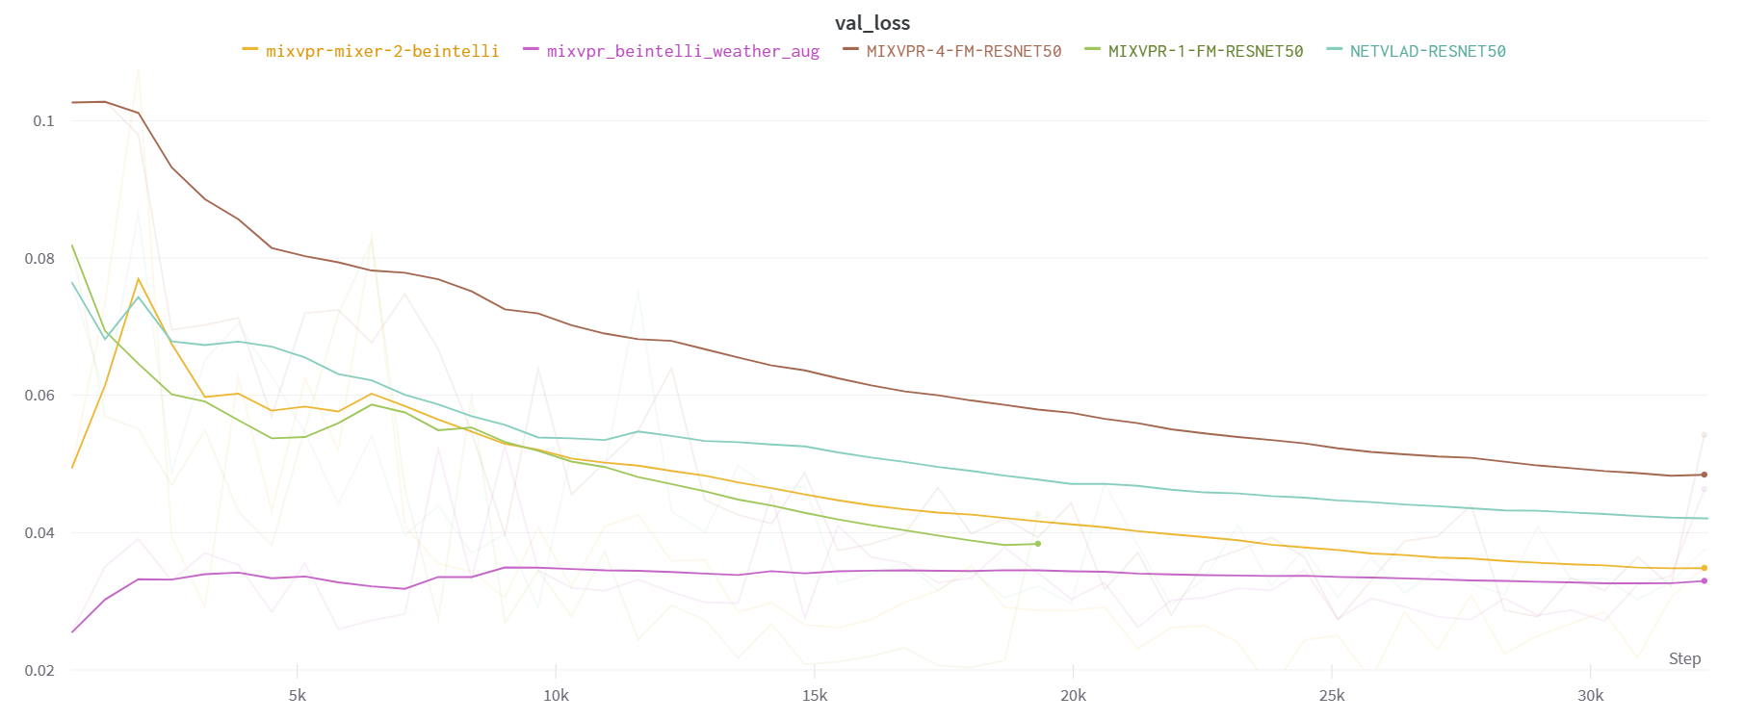
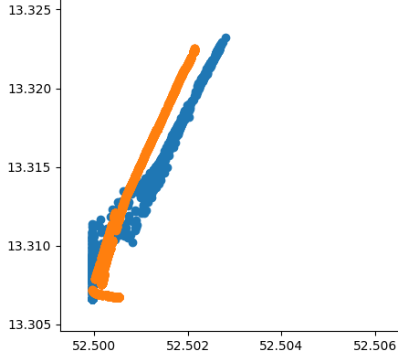
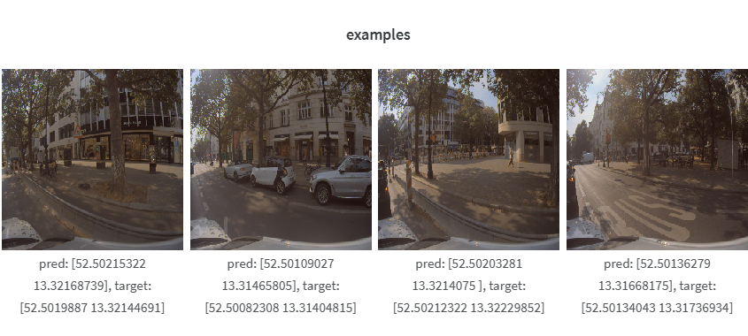
Results:
BeIntelli TP3

Slide 7
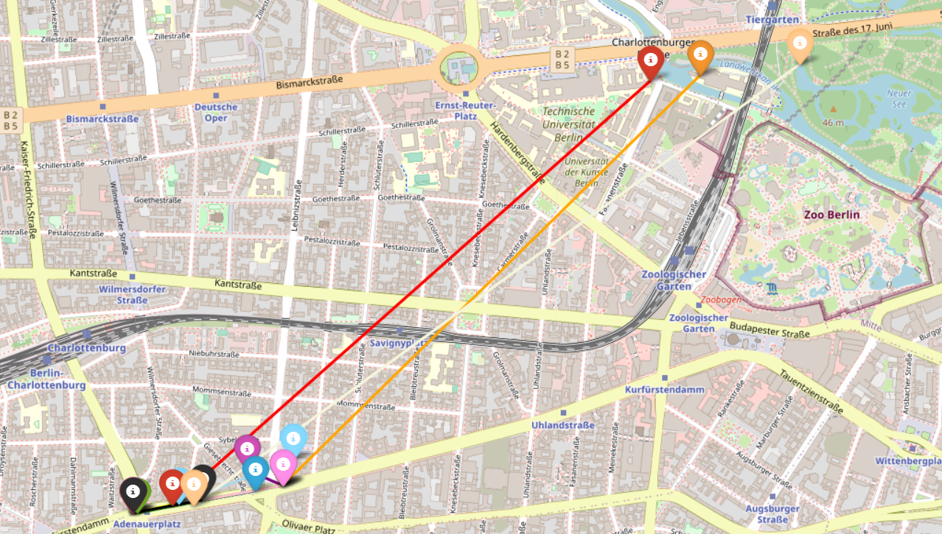

Slide 8
Future Works:
BeIntelli TP3
Increasing accuracy (less loss):
More hyperparameter tuning and testing with current MixVPR model
Instead of a basic CNN feature extraction, a more complex one such as attention-based transformers^{[13]}
Improvements in feature-mixer layer - a more complex and accurate layer if possible
Improved robustness to temporary and repeating objects like cars, humans and trees/buildings (ex. Zoo road and rural areas)^{[14][15][16]}
Combining RGB image data with lidar data^{[17]}

Slide 9
References:
BeIntelli TP3
[1] https://autoware.org/autoware-challenge-2023/
[2] A. Ali-bey, B. Chaib-draa, and P. Giguere, “Mixvpr: Feature mixing ` for visual place recognition,” in WACV, 2023.
[3] S. Lowry et al., "Visual Place Recognition: A Survey," in IEEE Transactions on Robotics, vol. 32, no. 1, pp. 1-19, Feb. 2016, doi: 10.1109/TRO.2015.2496823.
[4] Barros, T., Pereira, R., Garrote, L., Premebida, C., & Nunes, U. J. (2021). Place recognition survey: An update on deep learning approaches. arXiv preprint arXiv:2106.10458.
[5] Lowe, D.G. Distinctive Image Features from Scale-Invariant Keypoints. International Journal of Computer Vision 60, 91–110 (2004). https://doi.org/10.1023/B:VISI.0000029664.99615.94
[6] Bay, H., Tuytelaars, T., Van Gool, L. (2006). SURF: Speeded Up Robust Features. In: Leonardis, A., Bischof, H., Pinz, A. (eds) Computer Vision – ECCV 2006. ECCV 2006. Lecture Notes in Computer Science, vol 3951. Springer, Berlin, Heidelberg. https://doi.org/10.1007/11744023_32
[7] Oliva A, Torralba A. Building the gist of a scene: the role of global image features in recognition. Prog Brain Res. 2006;155:23-36. doi: 10.1016/S0079-6123(06)55002-2. PMID: 17027377.
[8] Arandjelovic, Relja & Zisserman, Andrew. (2013). All about VLAD. Proceedings of the IEEE Computer Society Conference on Computer Vision and Pattern Recognition. 1578-1585. 10.1109/CVPR.2013.207.
[9] H. Jégou, M. Douze, C. Schmid and P. Pérez, "Aggregating local descriptors into a compact image representation," 2010 IEEE Computer Society Conference on Computer Vision and Pattern Recognition, San Francisco, CA, USA, 2010, pp. 3304-3311, doi: 10.1109/CVPR.2010.5540039.
[10] Arandjelovic, R., Gronat, P., Torii, A., Pajdla, T., & Sivic, J. (2016). NetVLAD: CNN architecture for weakly supervised place recognition. In Proceedings of the IEEE conference on computer vision and pattern recognition (pp. 5297-5307).
[11] Uy, M. A., & Lee, G. H. (2018). Pointnetvlad: Deep point cloud based retrieval for large-scale place recognition. In Proceedings of the IEEE conference on computer vision and pattern recognition (pp. 4470-4479).
[12] Hausler, S., Garg, S., Xu, M., Milford, M., & Fischer, T. (2021). Patch-netvlad: Multi-scale fusion of locally-global descriptors for place recognition. In Proceedings of the IEEE/CVF Conference on Computer Vision and Pattern Recognition (pp. 14141-14152).
[13] Wang, R., Shen, Y., Zuo, W., Zhou, S., & Zheng, N. (2022). Transvpr: Transformer-based place recognition with multi-level attention aggregation. In Proceedings of the IEEE/CVF Conference on Computer Vision and Pattern Recognition (pp. 13648-13657).
[14] Keetha, N., Mishra, A., Karhade, J., Jatavallabhula, K. M., Scherer, S., Krishna, M., & Garg, S. (2023). AnyLoc: Towards Universal Visual Place Recognition. arXiv preprint arXiv:2308.00688.
[15] Michael McHenry, Yang Cheng, and Larry Matthies "Vision-based localization in urban environments", Proc. SPIE 5804, Unmanned Ground Vehicle Technology VII, (27 May 2005); https://doi.org/10.1117/12.603973
[16] Schubert, S., Neubert, P., Garg, S., Milford, M., & Fischer, T. (2023). Visual Place Recognition: A Tutorial. arXiv preprint arXiv:2303.03281.
[17] Komorowski, J., Wysoczańska, M., & Trzcinski, T. (2021, July). MinkLoc++: lidar and monocular image fusion for place recognition. In 2021 International Joint Conference on Neural Networks (IJCNN) (pp. 1-8). IEEE.

